Slide 1
Welcome to my presentation

Slide 2
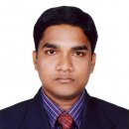
Presented by
Prashanta Banik
TOI: Batch 27
I.D: 09
English Teacher
Bamoi Model High School Bamoi, Lakhai, Hobiogonj
Cell: 01839-743939

Slide 3
English For Today
Grade: Nine/Ten
Unit: 12
Lesson : 01
Section: A
Student: 50

Slide 4
Learning Outcome
After we have Studied the lesson, we will able to…..
Enrich vocabulary
Explain Present Tense
Participate in conversation
Share personal views
Write transportation in Bangladesh

Slide 5
Lets enjoy a video

Slide 6
Vocabulary Development
Eid
.
Festival

Slide 7
Neighbor
Domestic

Slide 8
Tradition
custom

Slide 9
Grammar
Simple present tense structure
Sub+verb(s/es)+obj

Slide 10
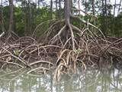
Topic Name Roots
Lesson Name
My Roots

Slide 11
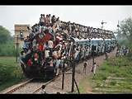
Silently Read Section ‘B’ & try to solve Section ‘C’

Slide 12
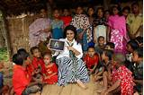
Pair work
Again read the section ‘B’ then Talk about question Section ‘C’ with your partners.

Slide 13
Possible Problems & Solution about two Sections
B & E…..

Slide 14
Evaluation Make a chart the types of Roots

Slide 15
Home Task Write a paragraph on Transportation in Bangladesh

